Slide 1
PROJECT PROPOSED ON
Classification of Diabetic Retinopathy Disease Levels by Extracting Topological Features Using GNN
Presented By Gavireddi Sathish
Reg.no :- 220200042011
Under The Guidance Of
Dr.M.RANI REDDY
Department Of MCA

Slide 2
Abstract
T Diabetic retinopathy happens due to damage in blood vessels and is the prominent reason for blindness worldwide. Clinical experts observe the fundus images to diagnose the disease, but it is often an error-prone and tedious task. Computer-assisted techniques will help clinicians to detect the disease severity levels. In medical imaging, experiments of automated diagnosis using CNN produce impressive results. Even though disease classification tasks in retinal images via CNN face difficulty in retaining high-quality information at the output. A new deep learning methodology is proposed based on a graph convolutional neural network (GCNN). The proposed model aims to extract the essential retinal image features effectively. The work focuses on extracting the features using a Variational autoencoder and identifying the underlying topological correlations using GCNN.

Slide 3
Existing System
In the existing system, a lot of time and effort to manually detect diabetic maculopathy. To improve the retinal image structure analysis, image processing methods are needed to design Computer Assisted Diagnostic (CAD) systems. Conventional machine learning-based methods exhibit excellent performance while performing automatically grading of DR and DME. Traditional machine learning techniques have the advantage of requiring fewer data and processing resources to train the algorithm. However, for feature engineering, domain knowledge is essential.

Slide 4
Drawbacks
Accuracy is low
More Time consuming
High Cost

Slide 5
Proposed System
In the Proposed system, a Deep Graph CNN (DGCNN) algorithm to improve detection accuracy. GraphCNN algorithm follow graph based architecture to extract and train features, algorithm will train features based on topological format where all close features will be easily distinguish which can help in accurate Retinopathy class detection and can increase accuracy. Propose model aims to extract the essential retinal image features effectively. The work focuses on extracting the features using a Variational autoencoder and identifying the underlying topological correlations using GCNN.

Slide 6
Advantages
High Accuracy
Less time consuming
Cost efficiency
Less coding

Slide 7
SOFTWARE REQUIREMENTS:
Operating system : Windows Family
Coding Language : Python

Slide 8
Hardware Components
Operating system: windows, linux
Processor : minimum intel i3
Ram: minimum 4 gb
Harddisk : minimum 250gb
27-Apr-23
Dept of MCA
8
Notes:
8

Slide 9
Modules
Upload EyePacs Dataset: using this module we can upload dataset folder to application and then it will read all images and labels from dataset and then resize all images to equal sizes
Pre-process Dataset: using this module application will shuffle, normalized and extract features from all images
Split Dataset Train & Test: using this module application will split all dataset images into train and test where application will be using 80% dataset images for training and 20% for testing
Train Propose GraphCNN Algorithm: 80% training features will be input to GraphCNN algorithm to train a model and then 20% test images will be applied on trained model to calculate prediction accuracy
Train DenseNet121 Algorithm: 80% training features will be input to DenseNet121 algorithm to train a model and then 20% test images will be applied on trained model to calculate prediction accuracy
Comparison Graph: using this module plotting comparison graph between all algorithms
Training Accuracy Graph: using this module application will plot training accuracy of both GraphCNN and DenseNdet121
Retinopathy Grade Detection: using this module we can upload test image to application and then GraphCNN will predict severity grade and extract features map image as output
27-Apr-23
Dept of MCA
9
Notes:
9

Slide 10
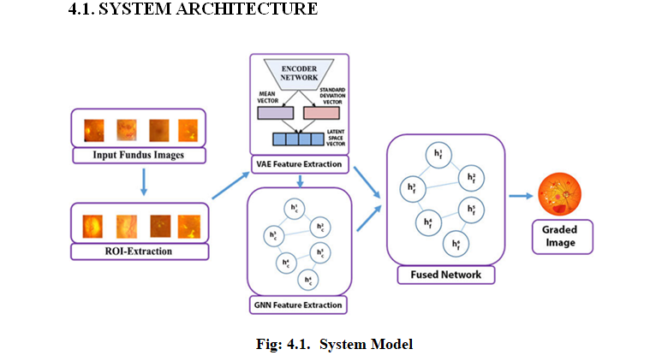

Slide 11
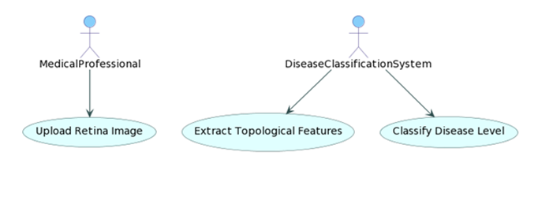
UML
27-Apr-23
Dept of MCA
11
Notes:
11

Slide 12
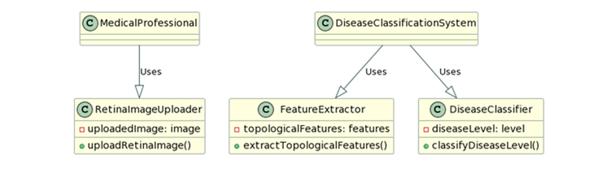

Slide 13
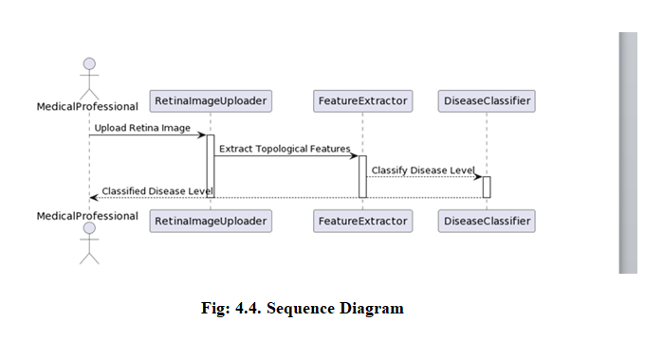

Slide 14
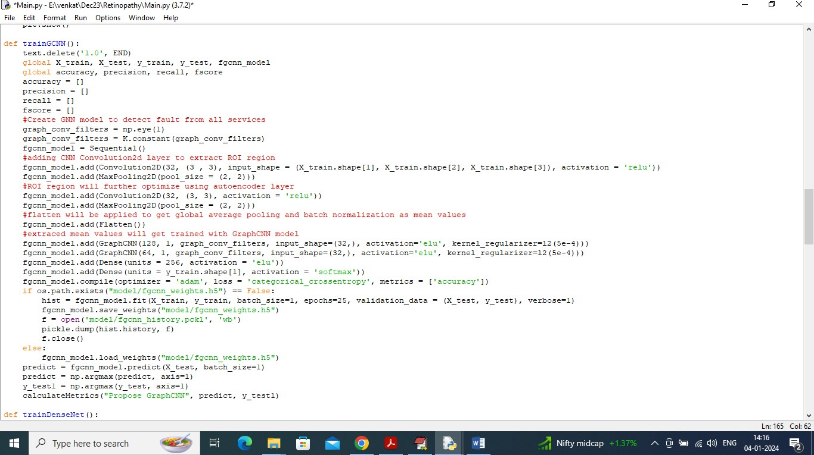
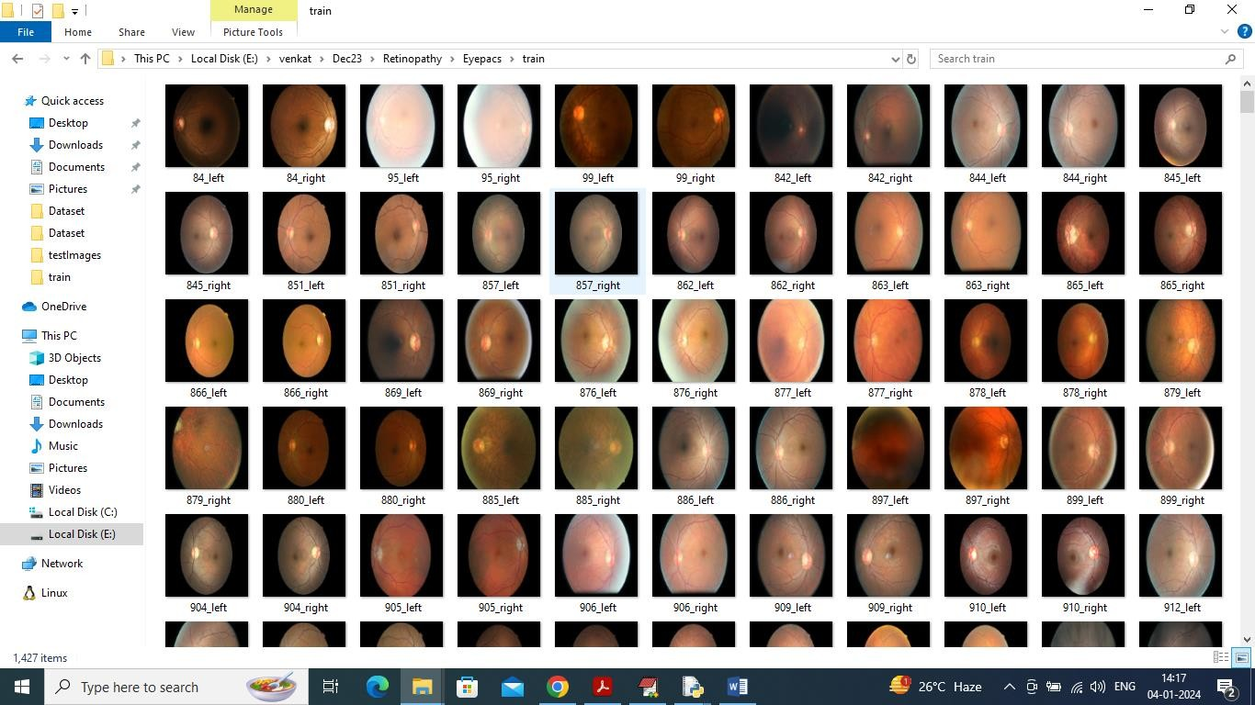
In above screen read red colour comments to know about propose GraphCNN algorithm. In below screen showing images from EYEPACS dataset
So by using above EYEPACS images will train and test both algorithm performance.

Slide 15
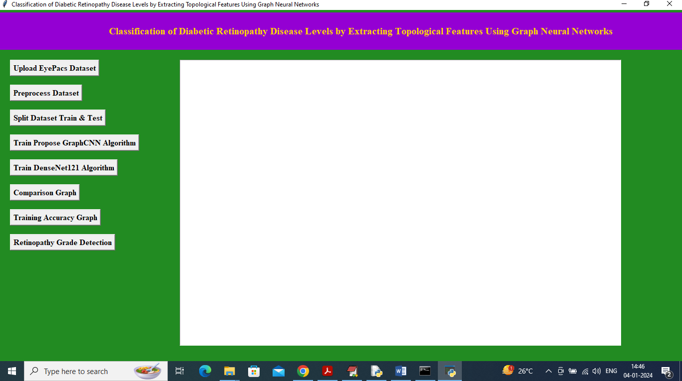
SCREEN SHOTS
To run project double click on ‘run.bat’ file to get below page
In above screen click on ‘Upload EyePacs Dataset’ button to upload dataset to application and then will get below output

Slide 16
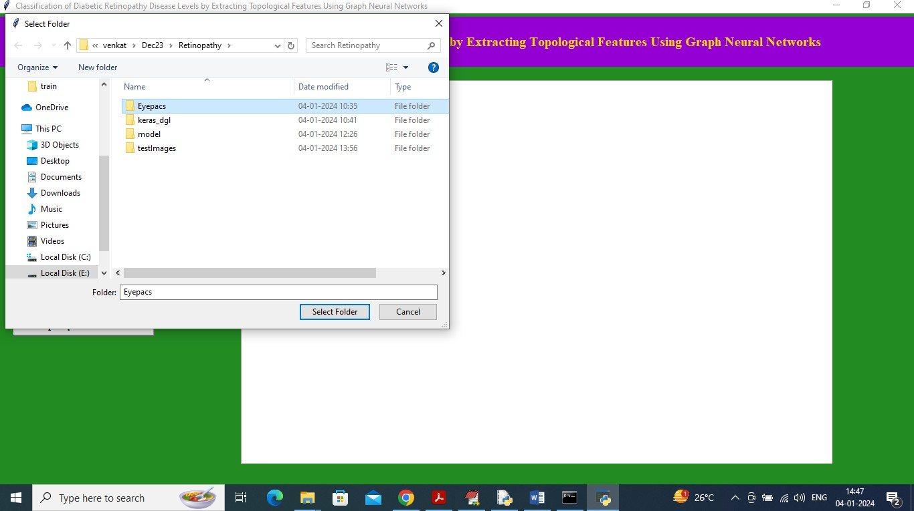
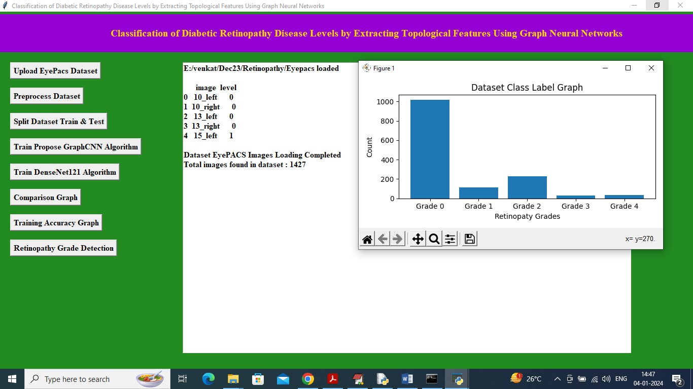
In above screen selecting and uploading ‘EYEPACS’ dataset folder and then click on ‘Select Folder’ button to load dataset and get below page
In above screen dataset loaded with image names and grade level and in graph x-axis represents different grades found in dataset and y-axis represents number of images found in that grade category and now close above graph and then click on ‘Pre-process dataset’ button to shuffle and normalize images and then will get below output

Slide 17
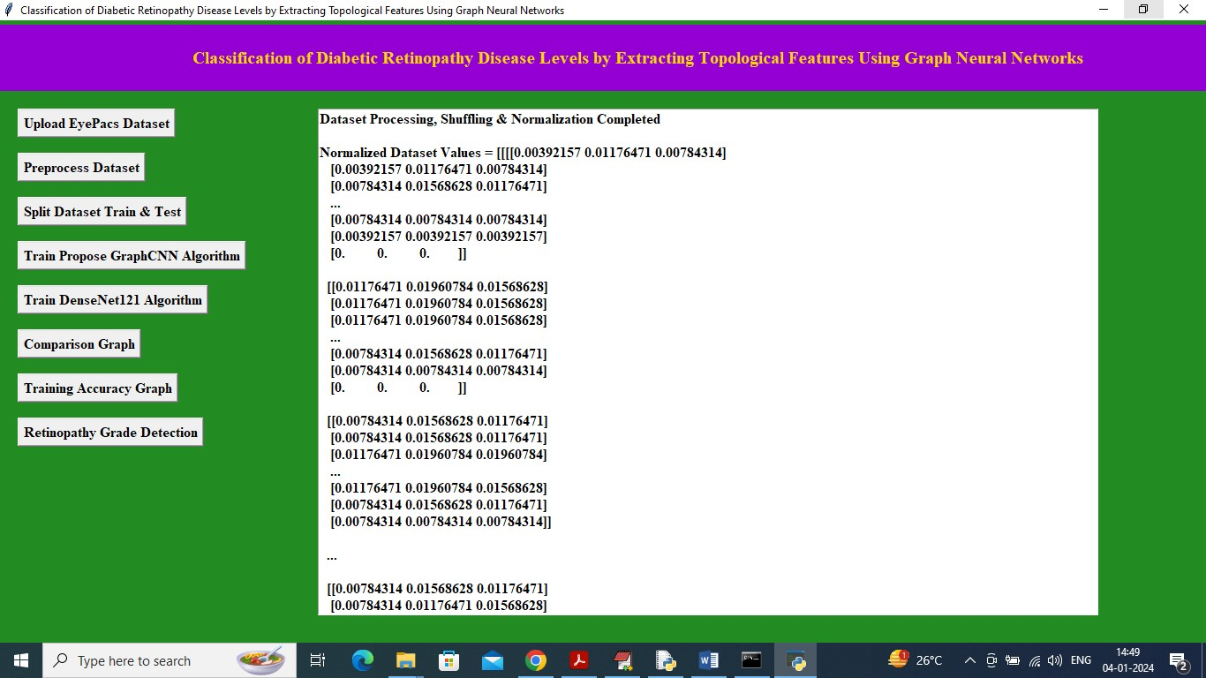
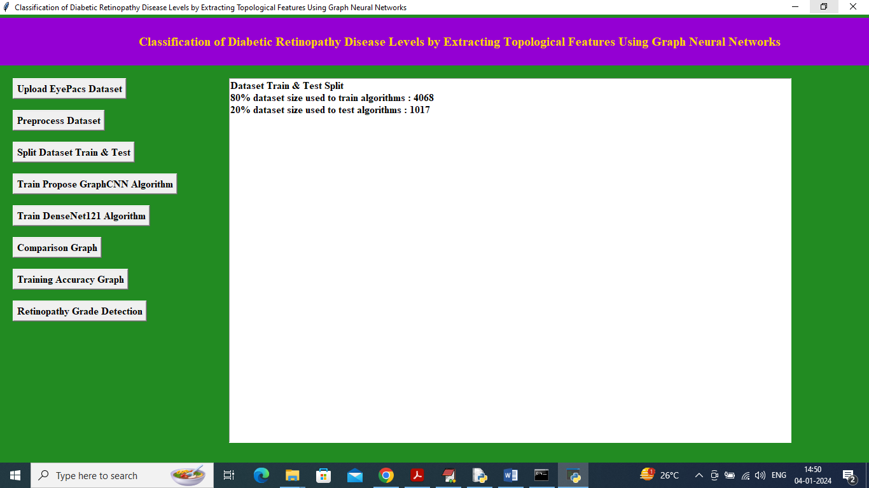
In above screen dataset processing completed and can see normalized image values and now click on ‘Split Dataset Train & Test’ button to split dataset into train and test will get below output
In above screen can see total images using for training and testing and now click on ‘Train Propose GraphCNN Algorithm’ button to train GraphCNN and get below output

Slide 18
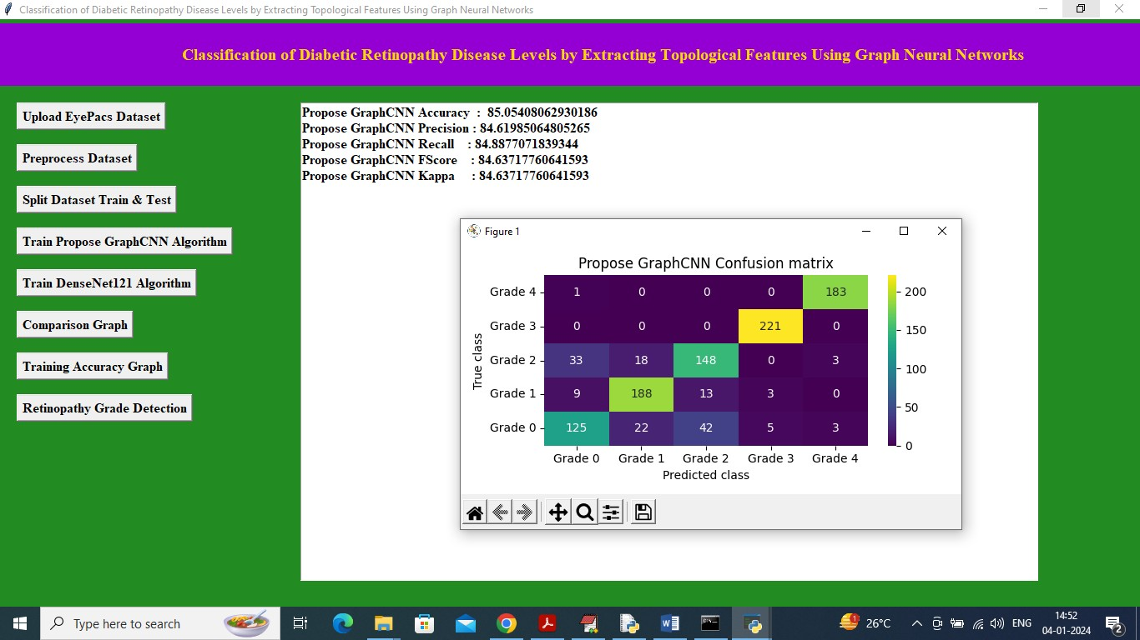
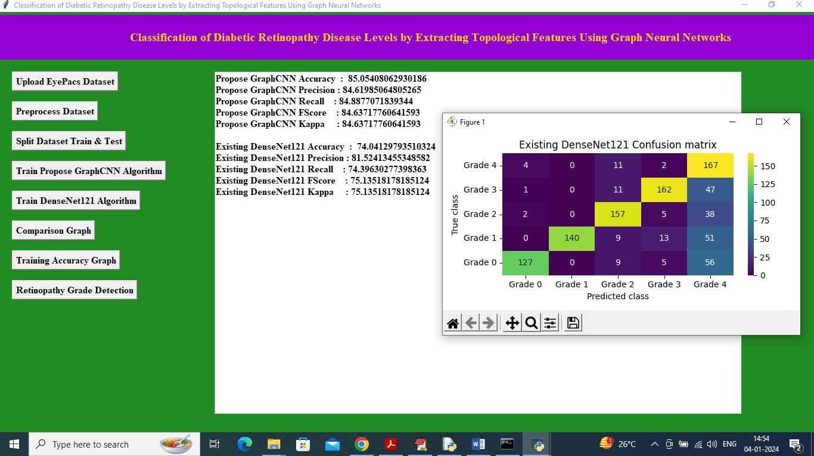
In above screen GraphCNN got 85% accuracy and can see other metrics like precision and KAPPA and in confusion matrix graph x-axis represents Predicted Labels and y-axis represents True Labels and all different colour boxes in diagnol represents correct prediction count and remaining blue boxes represents incorrect prediction count which are very few and now close above graph and then click on’ Train DenseNet121 Algorithm’ button to train DenseNet121 and will get below output
In above screen DenseNet121 got 74% accuracy and can see all other metrics output and now click on ‘Comparison Graph’ button to get below output

Slide 19
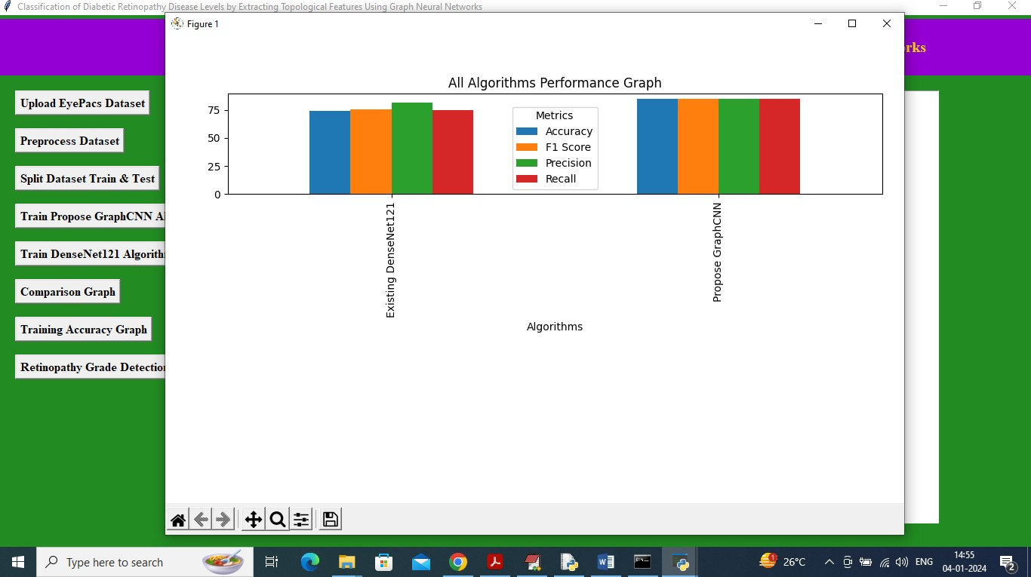
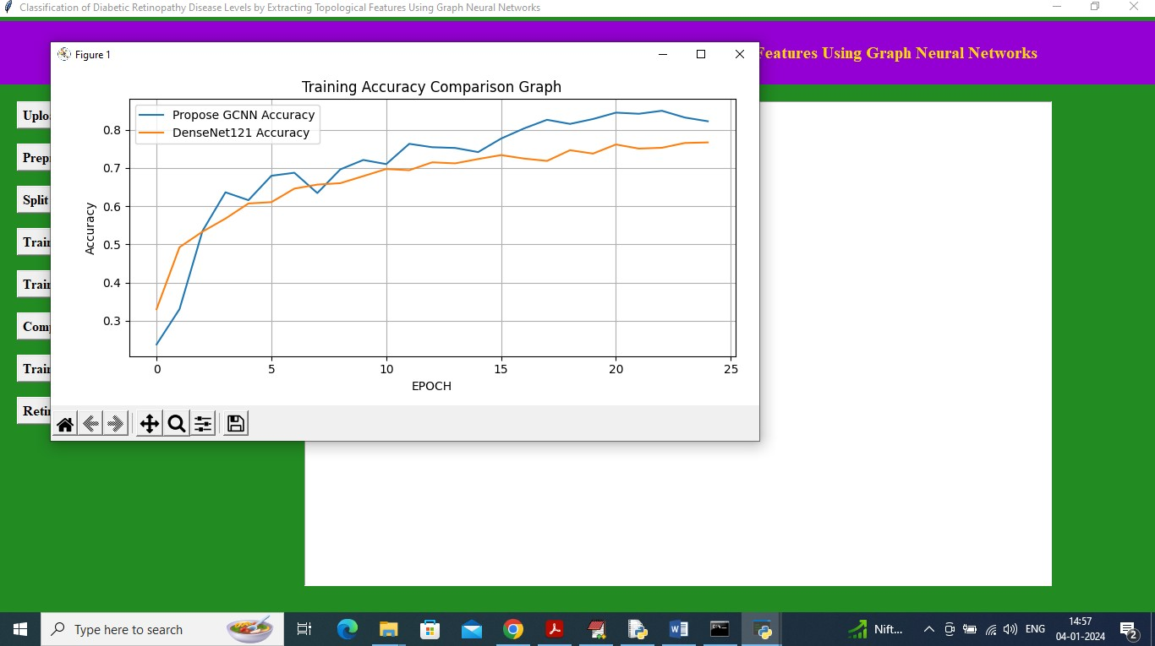
In above graph x-axis represents algorithm names and y-axis represents accuracy and other metrics in different colour bars and in both algorithms GraphCNN got high performance and now close above graph and the click on ‘Training Accuracy Graph’ button to get below graph
In above accuracy graph x-axis represents training epochs and y-axis represents accuracy and then blue line represents Propose GraphCNN and orange line represents Existing DenseNet121 and in both algorithms can see Propose GraphCNN got high accuracy. In above graph can see with each increasing epoch both algorithm accuracy got increase and reached closer to 1 but GraphCNN got high accuracy. Now click on ‘Retinopathy Grade Detection’ button to upload test image and get Grade severity and features map image

Slide 20
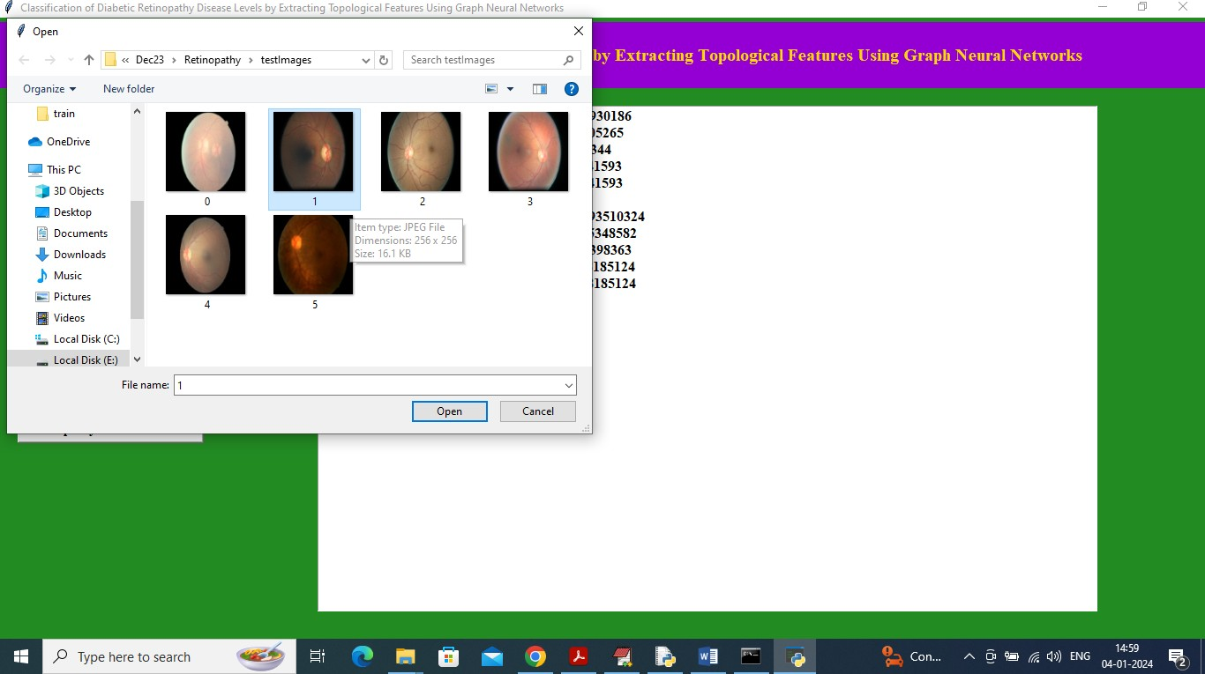
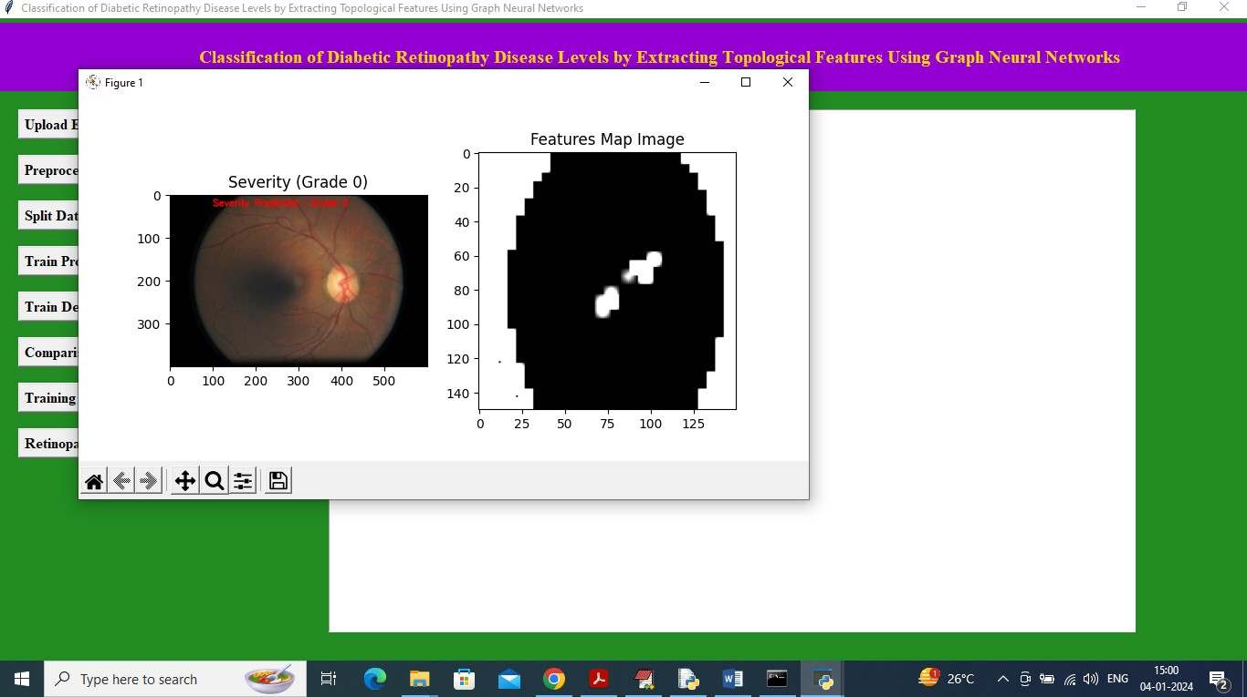
In above screen selecting and uploading ‘1.jpg’ image and then click on ‘Open’ button to get below output
In above screen in first image in red colour text can see Grade Severity predicted as 0 and in second image can see features map image extracted from Graph CNN and below are the other test input

Slide 21
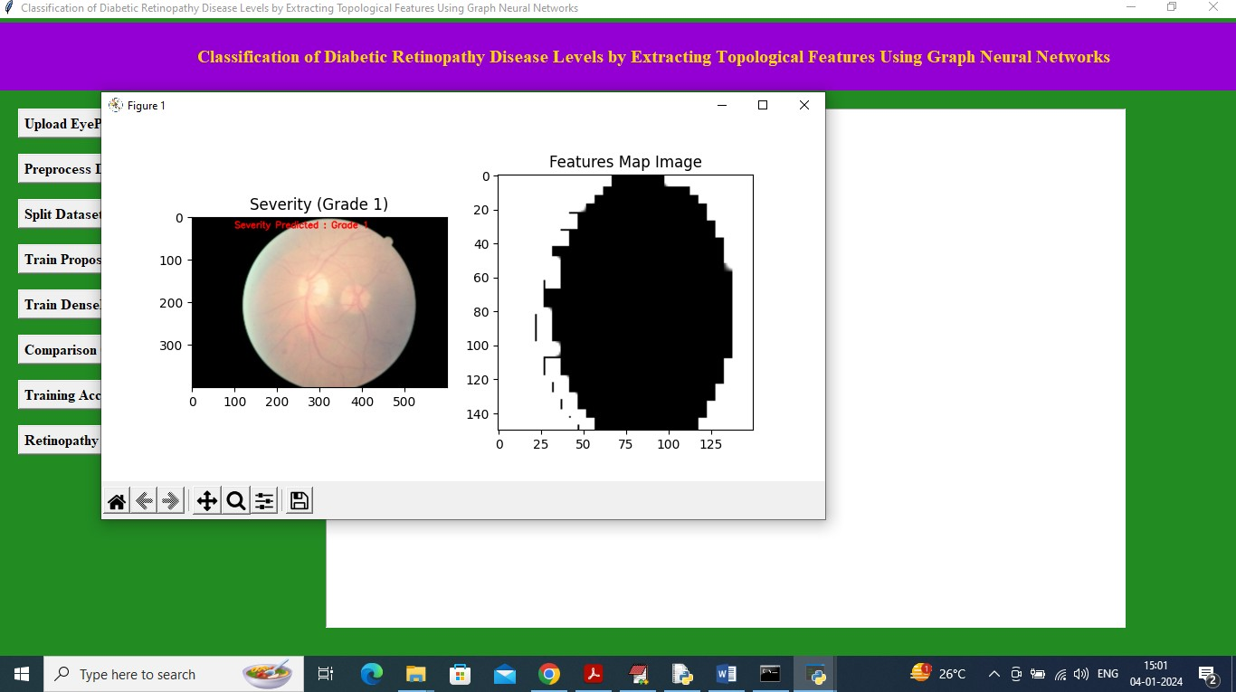
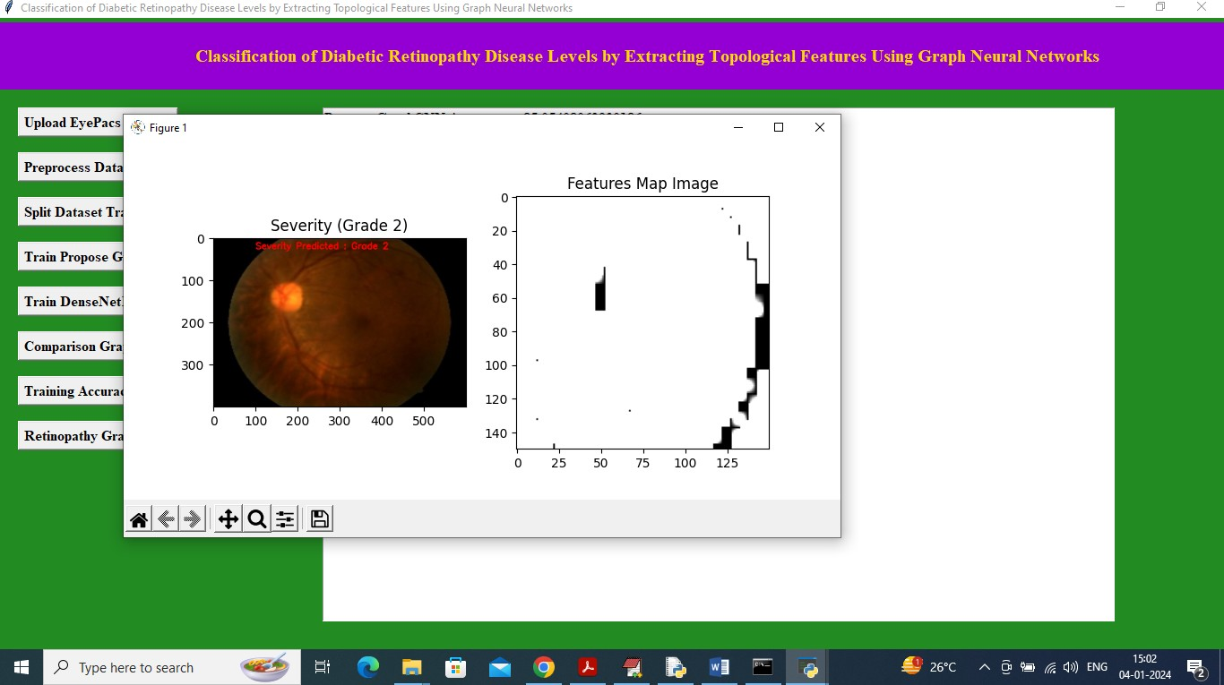
In above image predicted Grade is 1
In above screen Grade detected as 2

Slide 22
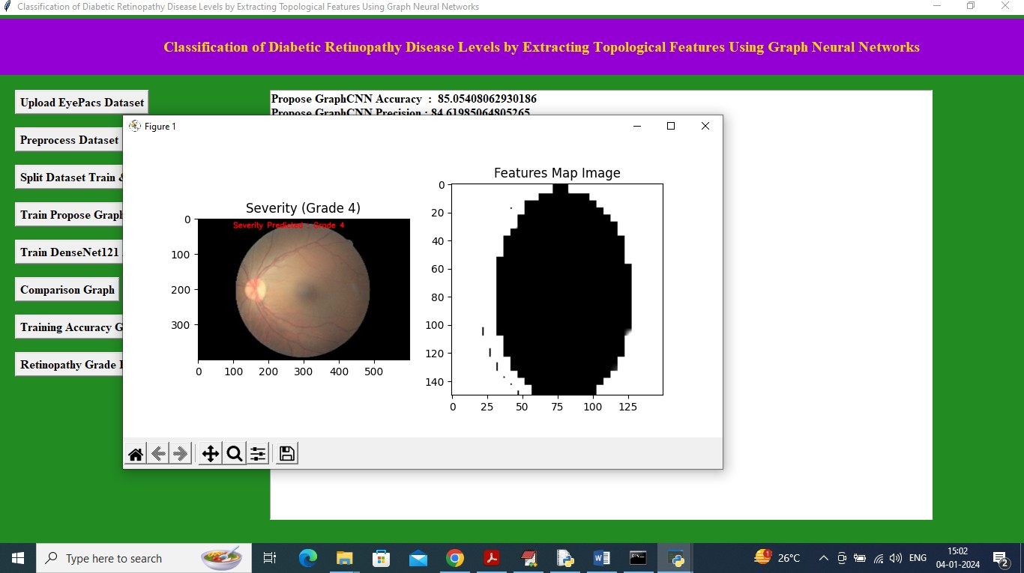
In above screen grade detected as 4 and similarly you can upload and test other images

Slide 23


